Slide 1
National Ignition Facility Neutron Sources
Hardened Electronics and Radiation Technology
C.5
Charles B. Yeamans and Brent E. Blue
April 17, 2018

Slide 2
National Ignition Facility Neutron Sources outline
Abstract
NIF overview
Using the NIF as a neutron source
Practical consideration for the user
Fusion spectra available
NIF neutron sources
Polar direct drive
CH PDXP
SiO₂ DDEP
Indirect drive
ICF cryogenic layered
DT gas Symcaps
IDEP
Summary table
Experimental Platforms
Exterior flange mounted and reentrant well
Snout-mounted auxiliary positions
Dynamic load packages
Hohlraum
Capsule
Neutron Source and Experimental Platform Development
Capsule microinjection doping
Neutron source development: yield enhancements
Experimental support ring and reduced source standoff
Reference table

Slide 3
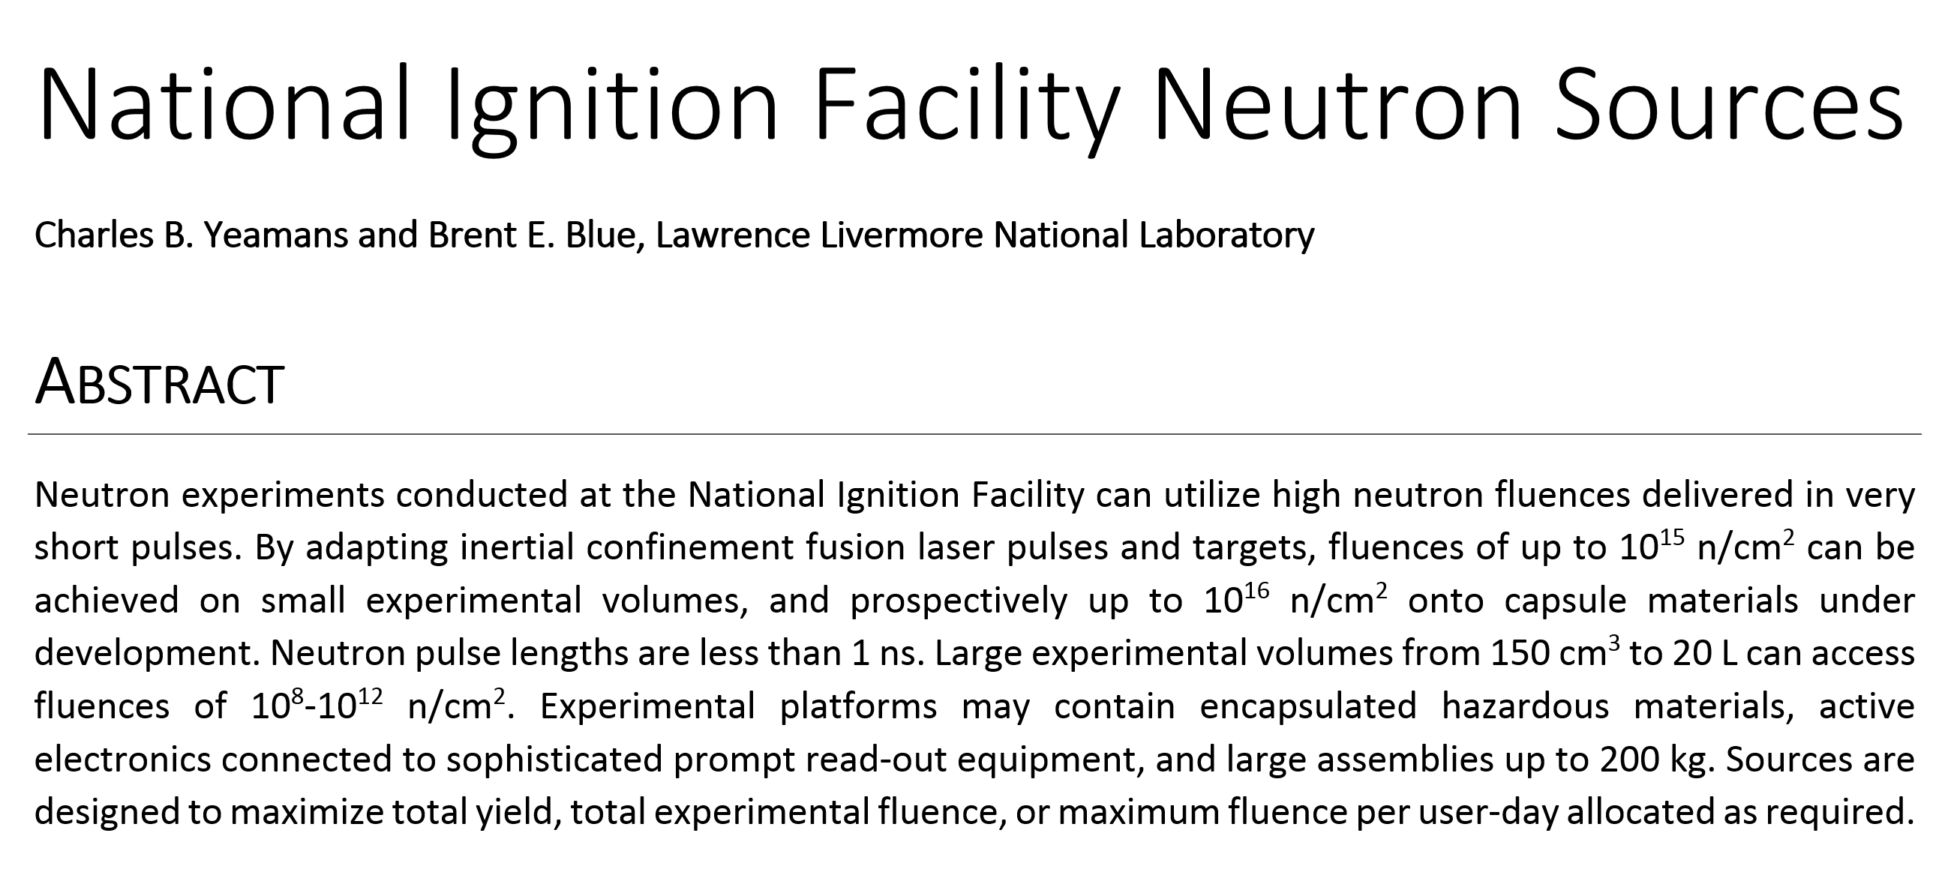
National Ignition Facility Neutron Sources

Slide 4
National Ignition Facility Neutron Sources outline
Abstract
NIF overview
Using the NIF as a neutron source
Practical consideration for the user
Fusion spectra available
NIF neutron sources
Polar direct drive
CH PDXP
SiO₂ DDEP
Indirect drive
ICF cryogenic layered
DT gas Symcaps
IDEP
Summary table
Experimental Platforms
Exterior flange mounted and reentrant well
Snout-mounted auxiliary positions
Dynamic load packages
Hohlraum
Capsule
Neutron Source and Experimental Platform Development
Capsule microinjection doping
Neutron source development: yield enhancements
Experimental support ring and reduced source standoff
Reference table

Slide 5
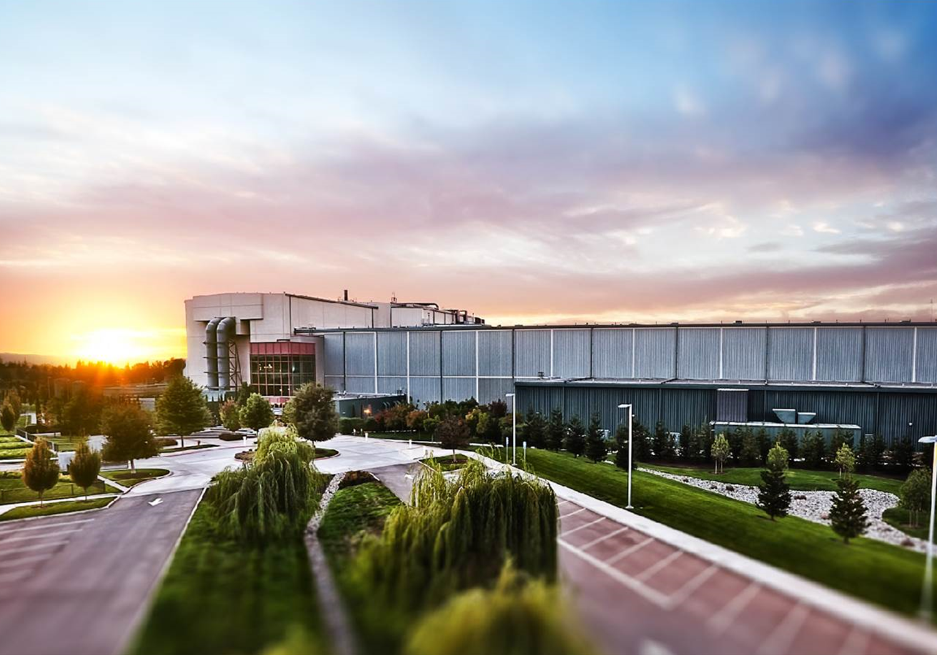
The National Ignition Facility is the world’s largest laser-driven neutron source.

Slide 6
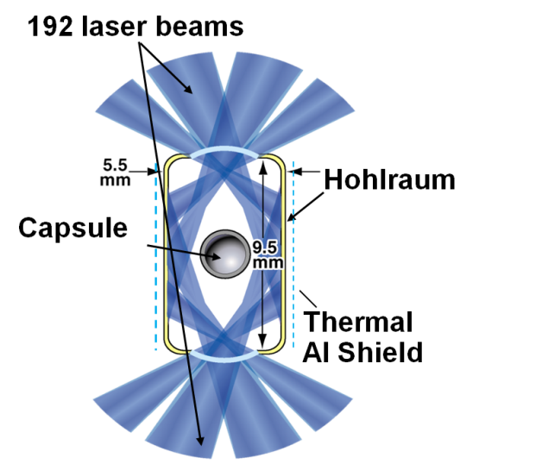
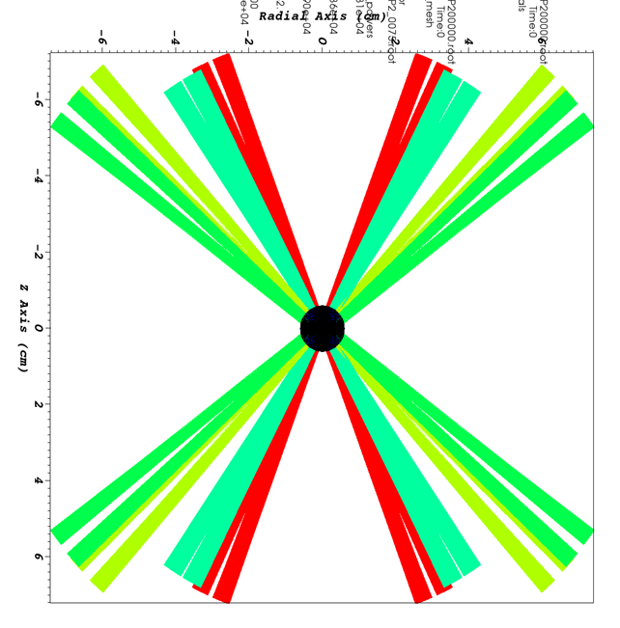
Overview: Using the NIF as a neutron source
Experiments enter through the NIF User Office or specific programs.
Based on user needs, individual experiments are fielded on an available NIF neutron yield shot.
Experiments are designed into a diagnostic instrument manipulator (DIM) or Target and Diagnostic Manipulator (TANDM), with design based on fluence an volume requirements.
 | Direct drive | Indirect drive
Capsule material | CH, SiO₂ | CH, C, Be, other
Hohlraum material | n/a | Au, Au/DU
Fielding temperature | 293 K | 293 K, 18-120 K
DT yield | 4 x 10¹⁵ | 1.7 x 10¹⁶
Burn duration (ps) | 250 | 150-200
Neutron thermal temperature (keV) | 8-15 | 2-5
Maximum fluence available (n/cm²)
Destructive | 3 x 10¹⁴ | 3 x 10¹⁵
nondestructive | 6 x 10¹² | 1.6 x 10¹³
DT neutrons per NIF optics log growth | 74 | 9

Slide 7
Overview: Practical considerations for a NIF user
Experiments allocated through accepted program proposals (JNSAC/NSA, HED and ICF councils, Discovery Science) can select their experimental configuration to best use the allocation.
Ride-along: Any NIF DT yield shot (29 in FY17, 26 in FY16) may support additional experiments through coordination with the campaign experimental team. This includes NIF facility neutron calibration shots as well as programmatic.
Optics Use: NIF is a rare laser facility operating above the optics damage threshold. A computational laser performance model helps determine the “optics use” per proposed laser shot in units of damage log growth.
Shot cycle length: Allocation is usually made in “user days.” Neutron yield shots have lengthy neutron mitigation procedures. Typical planning is one yield shot per user day.
Debris and Shrapnel: The experimental planning process at NIF focuses on machine safety and maintaining experimental throughput.

Slide 8
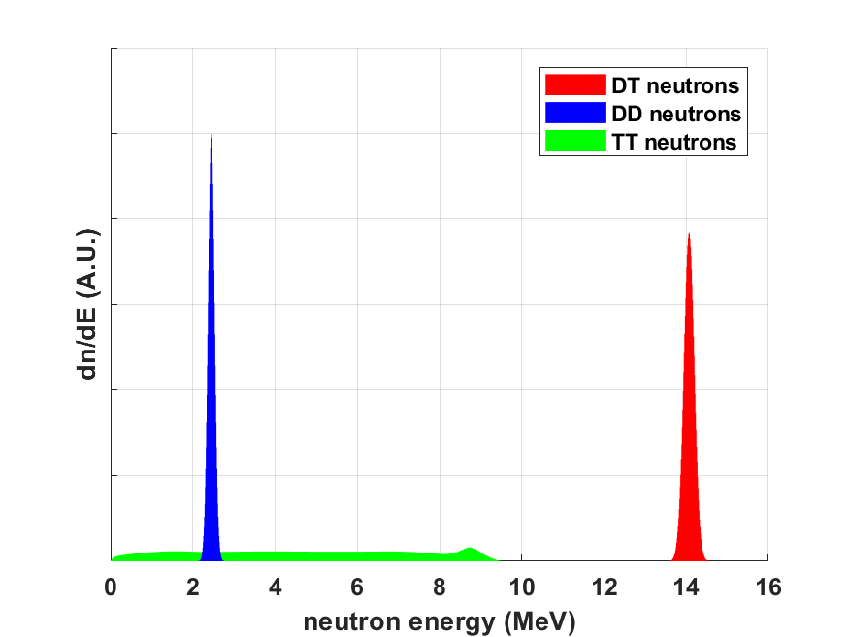
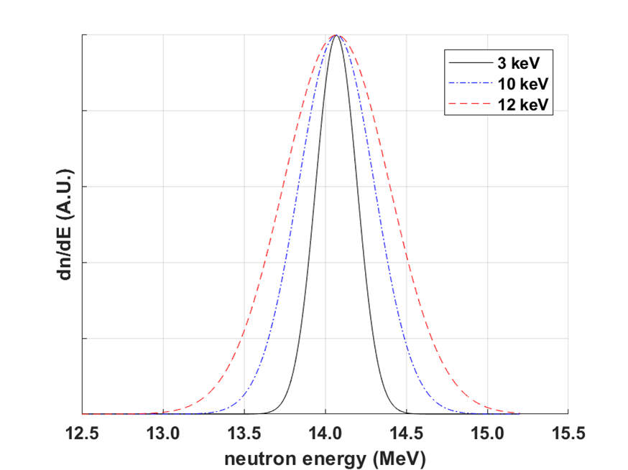
Overview: Fusion spectra available at NIF
All neutron sources have designs for 14 MeV deuterium-tritium (DT), 0-10 MeV pure tritium (TT), pure deuterium (DD), and He-3 and He-4 for charged particle sources.
Energy spectrum per source neutron for different gas fills
Energy spectrum per source DT neutron for different burn temperatures
Source yields for TT and DD are typically 1% of those for DT due to the difference in fusion reactivity of the respective species.

Slide 9
National Ignition Facility Neutron Sources outline
Abstract
NIF overview
Using the NIF as a neutron source
Practical consideration for the user
Fusion spectra available
NIF neutron sources
Polar direct drive
CH PDXP
SiO₂ DDEP
Indirect drive
ICF cryogenic layered
DT gas Symcaps
IDEP
Summary table
Experimental Platforms
Exterior flange mounted and reentrant well
Snout-mounted auxiliary positions
Dynamic load packages
Hohlraum
Capsule
Neutron Source and Experimental Platform Development
Capsule microinjection doping
Neutron source development: yield enhancements
Experimental support ring and reduced source standoff
Reference table

Slide 10
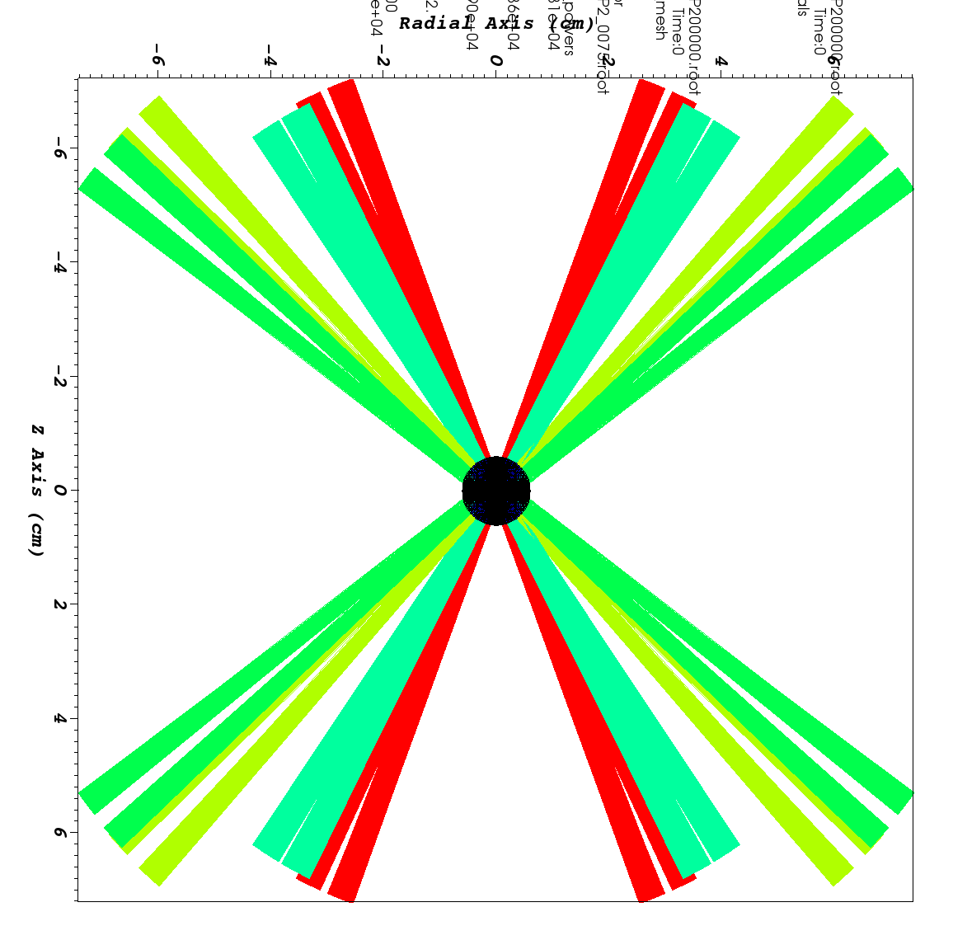
NIF Neutron Sources: Direct Drive
Because the NIF beam geometry supports experiments with z-oriented hohlraums, experiments utilizing laser energy depositions directly on the imploding surface are configured in a pole-hot geometry.
Subsequent fundamental physics work has refined the PDD technique to produce reliable high neutron yields using a simple, low-mass target assembly.
The low-mass target assembly reduced the debris wind load substantially, allowing neutron experiments using PDD sources to reduce their source standoff.

Slide 11
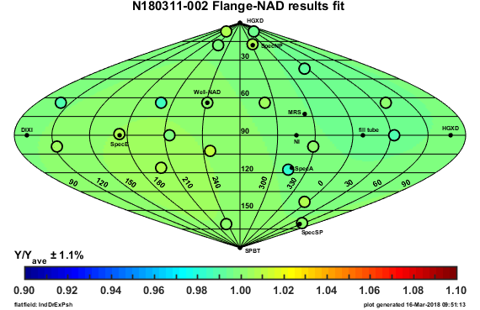
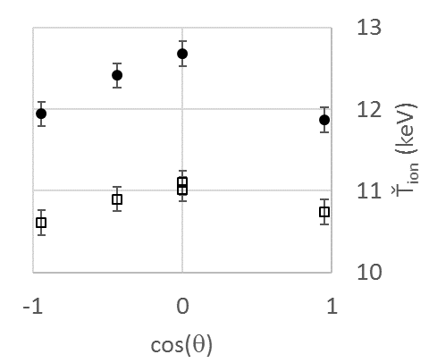
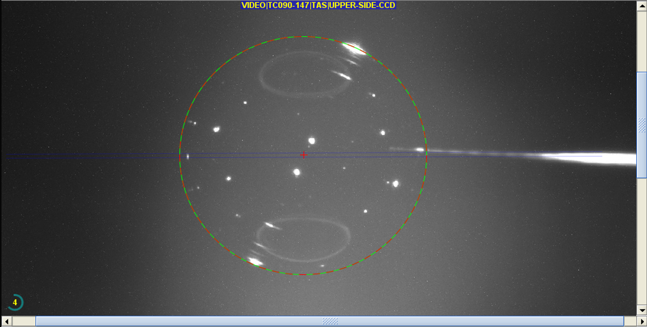
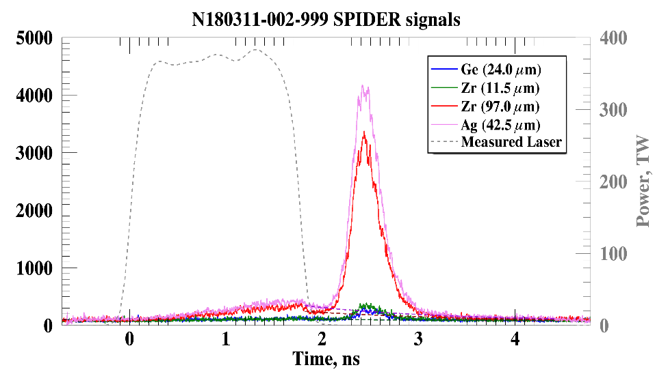
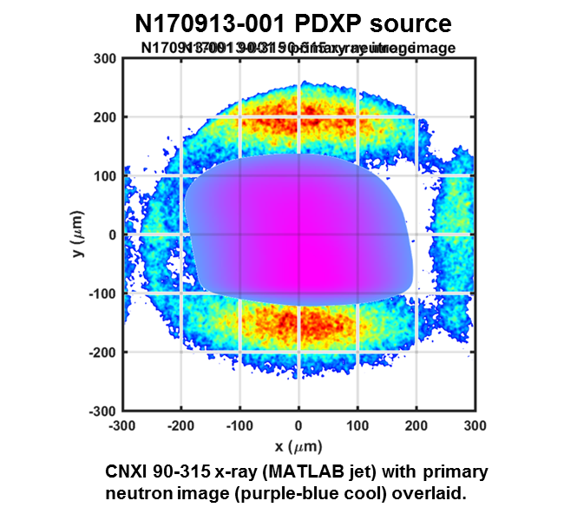
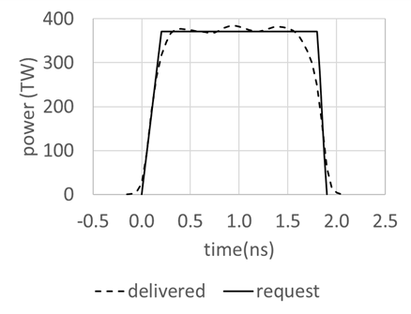
NIF Neutron Sources: Polar direct drive exploding pusher (PDXP)
 |  | PDXP
Inputs | Fill gas DT | 65:35
 | capsule pressure (torr) | 6080
 | Target temperature (K) | room
 | Laser energy (MJ) | 0.62
 | optics log growth per shot | 0.005
 | shot cycle time (h) | 9
Outputs | expected yield (DT) | 3.7 x 10¹⁵
 | Ť_{ion} (keV) | 12
 | burn width (ps) | 250-300
 | neutron volume (mm³) | 0.05
 | output spectrum | pure DT
 | minimum sample standoff (cm) | 1
 | minimum DLP standoff (cm) | 5
Metrics | 10¹⁵ neutrons/optics log growth | 740
 | doping capsule/fill | y/y
 | max fluence: destructive (n/cm²) | 2.9 x 10¹⁴
 | max fluence: non-destructive (n/cm²) | 1.2 x 10¹³
Target
Material: CH (GDP)
Outer diameter: 2.9 mm
Thickness: 18 microns
Gas fill: 65:35 DT, 8 atm (1.6 mg/cc)
Temperature: warm (293 K)
Neutron mode 1 (=0)
Neutron mode 2 (≠0)
FNAD: Charles Yeamans
NTOF: SAVI dashboard
Time-resolved spatially-integrated x-ray emission
drive
bang
SPIDER: Shahab Khan
As N_Sdev_ExPsh moves to improved capsules, x-ray yield is expected to increase 5x.
PDXP Laser (28.6 % cone fraction)
PDXP source is a pure 14 MeV DT fusion output from a nearly massless system.
Target downscatter is minimized and required experimental standoff is less than for cooled targets.
allows 5 cm source standoff
Targets are relatively easy to field, possible to execute 2 shots in one user shot/day.
~10¹⁵ W/cm² at capsule

Slide 12
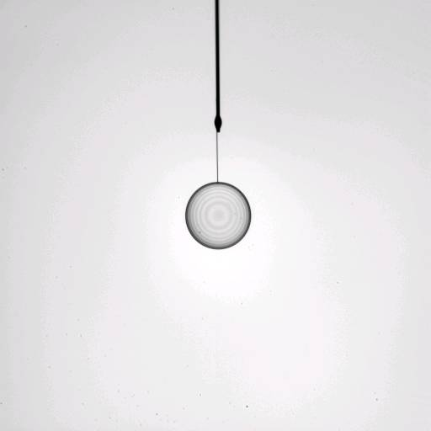
NIF Neutron Sources: glass direct drive exploding pusher (DDEP)
 |  | DDEP
Inputs | Fill gas DT | 50:50
 | capsule pressure (torr) | 7600
 | Target temperature (K) | room
 | Laser energy (MJ) | 0.82
 | optics log growth per shot | 0.01
 | shot cycle time (h) | 9
Outputs | expected yield (DT) | 8 x 10¹⁴
 | Ť_{ion} (keV) | 7
 | burn width (ps) | 250-300
 | neutron volume (mm³) | 0.05
 | output spectrum | pure DT
 | minimum sample standoff (cm) | 4
 | minimum DLP standoff (cm) | 5
Metrics | 10¹⁵ neutrons/optics log growth | 80
 | doping capsule/fill | n/y
 | max fluence: destructive (n/cm²) | 4.0 x 10¹²
 | max fluence: non-destructive (n/cm²) | 2.5 x 10¹²
diffusion-filled SiO₂ capsule up to 2.1 mm in diameter
The diffusion filling process allows for precisely-tuned gas fills that may not be practically adapted to the NIF shot-time gas fill system
Max fuel pressure is limited only by capsule burst and not NIF gas delivery rating
ability to suppress DT yield using high-Z noble gas fill dopants.
SiO₂
DT gas
2.1 mm

Slide 13
NIF Neutron Sources: Indirect Drive
indirect drive smooths the radiation profile impinging on the ablating surface substantially.
has been the choice of the NIF ICF ignition science program.
Indirect drive neutron sources have been developed and tested over a wide range of neutron yield and output spectrum parameters.
The target assemblies are relatively massive, therefore limiting the minimum source-experiment standoff.

Slide 14
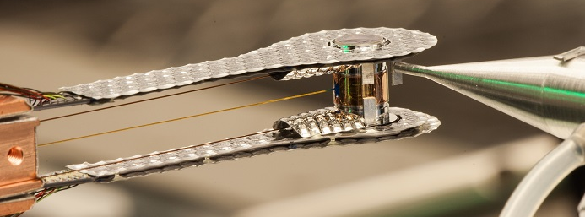
NIF Neutron Sources: indirect drive exploding pusher (IDEP)
 |  | IDEP
Inputs | Fill gas DT | 50:50
 | capsule pressure (torr) | 2487
 | Target temperature (K) | 32
 | Laser energy (MJ) | 0.71
 | optics log growth per shot | 0.027
 | shot cycle time (h) | 16
Outputs | expected yield (DT) | 5.5 x 10¹⁴
 | Ť_{ion} (keV) | 5
 | burn width (ps) | 250-300
 | neutron volume (mm³) | 0.05
 | output spectrum | pure DT
 | minimum sample standoff (cm) | 0.5
 | minimum DLP standoff (cm) | 10
Metrics | 10¹⁵ neutrons/optics log growth | 20
 | doping capsule/fill | y/y
 | max fluence: destructive (n/cm²) | 1.7 x 10¹⁴
 | max fluence: non-destructive (n/cm²) | 4.4 x 10¹¹
By designing the capsule and laser around a minimum of ablator mass remining, a neutron source with negligible capsule or room return scatter can be created.
Because the target assembly relies on a hohlraum, experimenters have been successful using the hohlraum thermomechanical package as a mounting surface to conduct neutron experiments on small samples of materials, which are collected as debris postshot using standard nuclear forensic techniques.

Slide 15
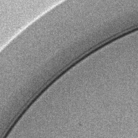
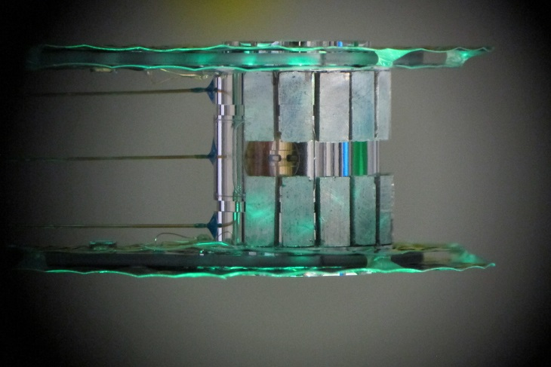
NIF Neutron Sources: DT gas-filled Symcap
 |  | CH Sym | HDC Sym
Inputs | Fill gas DT | 50:50 | 50:50
 | capsule pressure (torr) | 2892 | 1478
 | Target temperature (K) | 32 | 32
 | Laser energy (MJ) | 0.91 | 1.3
 | optics log growth per shot | 0.025 | 0.11
 | shot cycle time (h) | 16 | 18
Outputs | expected yield (DT) | 8 x 10¹⁴ | 4.5 x 10¹⁵
 | Ť_{ion} (keV) | 2.8 | 3.8
 | burn width (ps) | 200-250 | 175-225
 | neutron volume (mm³) | 0.0009 | 0.0009
 | output spectrum | DT + 1% downscatter | DT + 0.5% downscatter
 | minimum sample standoff (cm) | 0.5 | 0.5
 | minimum DLP standoff (cm) | 10 | 10
Metrics | 10¹⁵ neutrons/optics log growth | 32 | 41
 | doping capsule/fill | y/y | n/y
 | max fluence: destructive (n/cm²) | 2.5 x 10¹⁴ | 1.4 x 10¹⁵
 | max fluence: non-destructive (n/cm²) | 6.3 x 10¹¹ | 3.6 x 10¹²
cold capsule fill gas (32-128 K) allows fuel gas density up to 9 mg/cc
less complicated target operations and faster shot cycles than the layered platform.
HDC ablators may have DT yields up to 4.3 x 10¹⁵
GDP plastic ablators have yielded up to 8 x 10¹⁴, and may be doped with:
a wide variety of materials through ion implantation or deposition during the capsule growth
sub-microgram quantities of dopants for separated isotope cross section experiments
capsule outer surface
175 micron GDP
20 nm DU layer
capsule inner surface
SymCDT target with mass-tamped hohlraum

Slide 16
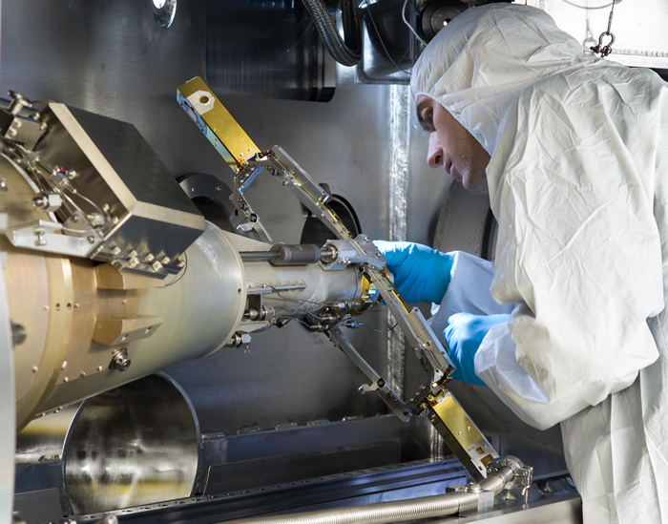
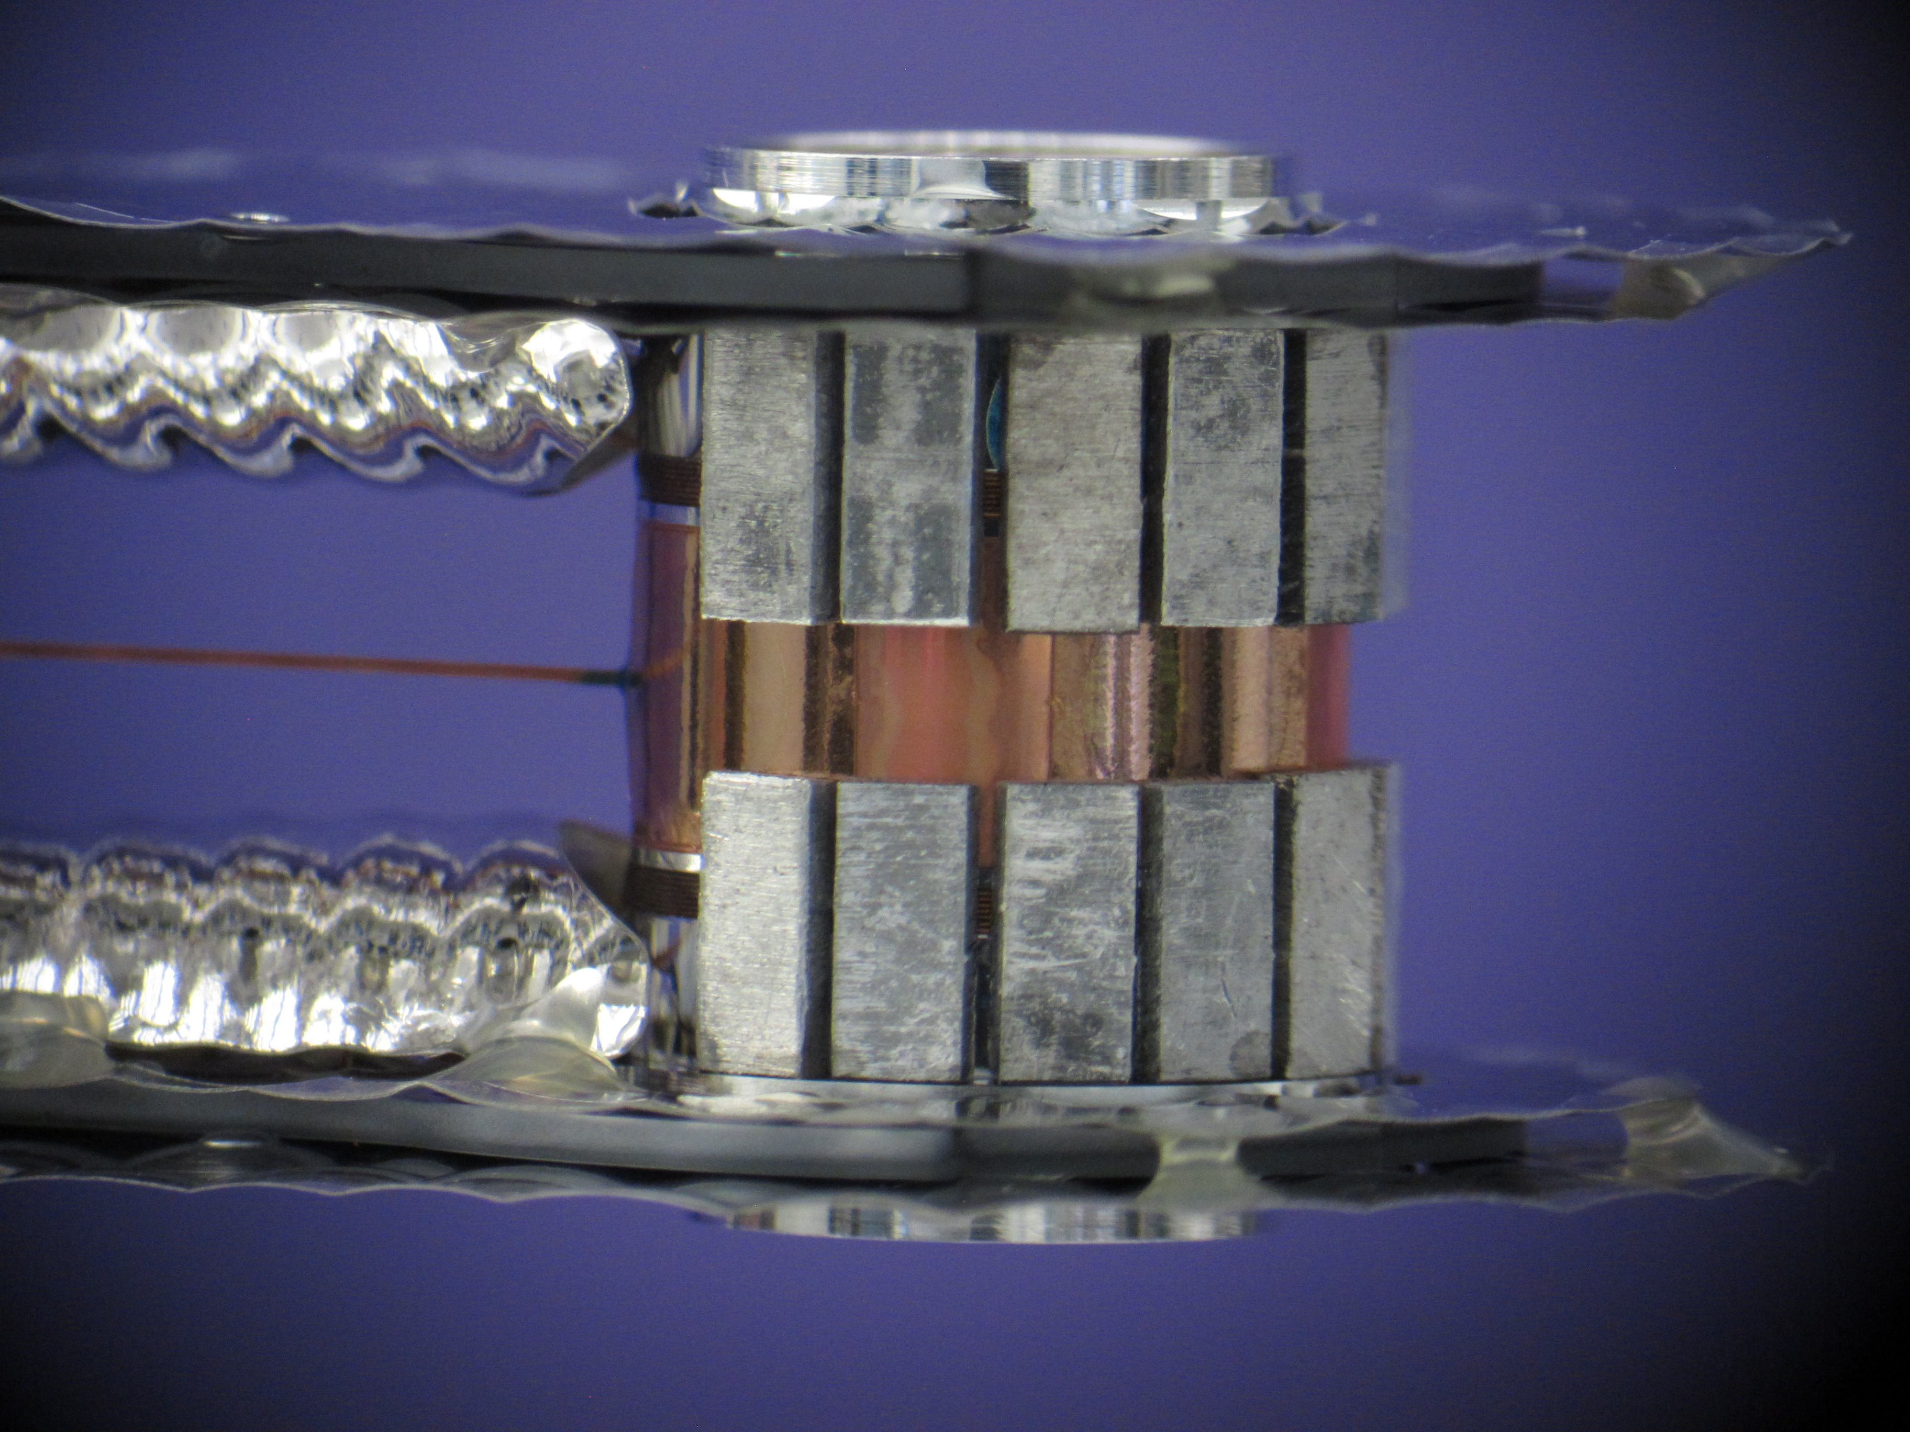
NIF Neutron Sources: DT cryogenic layered
 |  | layered
Inputs | Fill gas DT | 50:50
 | capsule pressure (torr) | 68
 | Target temperature (K) | 18.6
 | Laser energy (MJ) | 1.8
 | optics log growth per shot | 0.18
 | shot cycle time (h) | 24
Outputs | expected yield (DT) | 1.8 x 10¹⁶
 | Ť_{ion} (keV) | 3-5.5
 | burn width (ps) | 175-225
 | neutron volume (mm³) | 0.0001
 | output spectrum | DT + 1-5% downscatter
 | minimum sample standoff (cm) | 0.5
 | minimum DLP standoff (cm) | 10
Metrics | 10¹⁵ neutrons/optics log growth | 100
 | doping capsule/fill | y/n
 | max fluence: destructive (n/cm²) | 5.7 x 10¹⁵
 | max fluence: non-destructive (n/cm²) | 1.4 x 10¹³
Cryogenic DT ice layers are driven to convergence ratios of 20-35 to produce the highest NIF DT yields.
Capsules of different materials can be uses to select yield, spectrum properties, and dopant capability.
Experimental volume limited by shroud clearance.
High optics and facility time use: “expensive” shots.
A “shroud” is necessary to maintain temperature stability prior to shot. Clearance for shroud opening limits volume remaining for the neutron experiment.

Slide 17
NIF Neutron Sources: Summary table
 |  | PDXP | DDEP | IDEP | CH Sym | HDC Sym | layered
Inputs | Fill gas DT | 65:35 | 50:50 | 50:50 | 50:50 | 50:50 | 50:50
 | capsule pressure (torr) | 6080 | 7600 | 2487 | 2892 | 1478 | 68
 | Target temperature (K) | room | room | 32 | 32 | 32 | 18.6
 | Laser energy (MJ) | 0.62 | 0.82 | 0.71 | 0.91 | 1.3 | 1.8
 | optics log growth per shot | 0.005 | 0.01 | 0.027 | 0.025 | 0.11 | 0.18
 | shot cycle time (h) | 9 | 9 | 16 | 16 | 18 | 24
Outputs | expected yield (DT) | 3.7 x 10¹⁵ | 8 x 10¹⁴ | 5.5 x 10¹⁴ | 8 x 10¹⁴ | 4.5 x 10¹⁵ | 1.8 x 10¹⁶
 | Ť_{ion} (keV) | 12 | 7 | 5 | 2.8 | 3.8 | 3-5.5
 | burn width (ps) | 250-300 | 250-300 | 250-300 | 200-250 | 175-225 | 175-225
 | neutron volume (mm³) | 0.05 | 0.05 | 0.05 | 0.0009 | 0.0009 | 0.0001
 | output spectrum | pure DT | pure DT | pure DT | DT + 1% downscatter | DT + 0.5% downscatter | DT + 1-5% downscatter
 | minimum sample standoff (cm) | 1 | 4 | 0.5 | 0.5 | 0.5 | 0.5
 | minimum DLP standoff (cm) | 5 | 5 | 10 | 10 | 10 | 10
Metrics | 10¹⁵ neutrons/optics log growth | 740 | 80 | 20 | 32 | 41 | 100
 | doping capsule/fill | y/y | n/y | y/y | y/y | n/y | y/n
 | max fluence: destructive (n/cm²) | 2.9 x 10¹⁴ | 4.0 x 10¹² | 1.7 x 10¹⁴ | 2.5 x 10¹⁴ | 1.4 x 10¹⁵ | 5.7 x 10¹⁵
 | max fluence: non-destructive (n/cm²) | 1.2 x 10¹³ | 2.5 x 10¹² | 4.4 x 10¹¹ | 6.3 x 10¹¹ | 3.6 x 10¹² | 1.4 x 10¹³

Slide 18
National Ignition Facility Neutron Sources outline
Abstract
NIF overview
Using the NIF as a neutron source
Practical consideration for the user
Fusion spectra available
NIF neutron sources
Polar direct drive
CH PDXP
SiO₂ DDEP
Indirect drive
ICF cryogenic layered
DT gas Symcaps
IDEP
Summary table
Experimental Platforms
Exterior flange mounted and reentrant well
Snout-mounted auxiliary positions
Dynamic load packages
Hohlraum
Capsule
Neutron Source and Experimental Platform Development
Capsule microinjection doping
Neutron source development: yield enhancements
Experimental support ring and reduced source standoff
Reference table

Slide 19
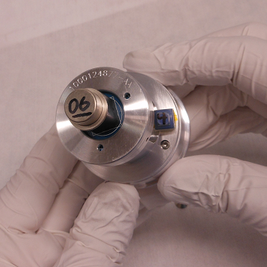
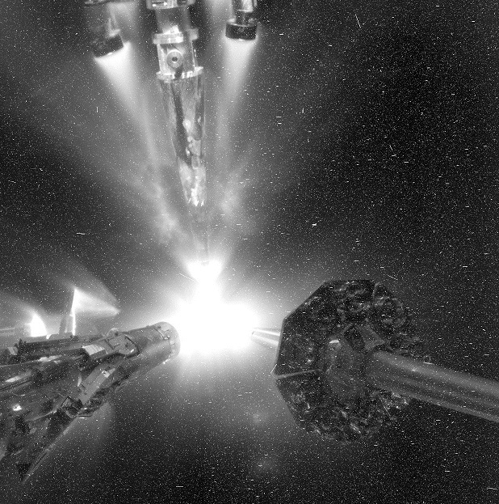
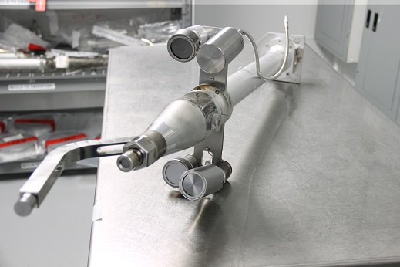
Many neutron experiments are assembled onto a single NIF shot.
 | capsule | hohlraum | support ring | DLP | Treefrog | HTOAD | SRC Toad | Snout-NAD | test well sample | reentrant well | port flange
distance from TCC (cm) | 0.1 | 0.5 | 1 | 5 | 7 | 45 | 50 | 50 | 350 | 375 | 550
sample area (cm²) |  | 0.05 | 3 | 90 | 0.5 | 20 | 4.9 | 20 | 37 | 1250 | 1250
sample depth (cm) |  | 0.05 | 0.5 | 20 | 0.14 | 8 | 0.1 | 1 | 1 | 1000 | 20
solid angle (msr) |  | 200 | 3000 | 3600 | 10 | 10 | 2.0 | 8.0 | 0.3 | 8.9 | 4.1
Volume (cm³) |  | 0.0025 | 1.5 | 1800 | 0.07 | 160 | 0.5 | 20 | 37 | 1.25 x 10⁶ | 25,000
max DT neutron yield | 4.0 x 10¹⁴ | 1.7 x 10¹⁶ | 3.7 x 10¹⁵ | 3.7 x 10¹⁵ | 3.7 x 10¹⁵ | 1.7 x 10¹⁶ | 1.7 x 10¹⁶ | 1.7 x 10¹⁶ | 1.7 x 10¹⁶ | 1.7 x 10¹⁶ | 1.7 x 10¹⁶
max fluence (n/cm²) | 3.2 x 10¹⁵ | 5.4 x 10¹⁵ | 2.9 x 10¹⁵ | 1.2 x 10¹³ | 6.0 x 10¹² | 6.7 x 10¹¹ | 5.4 x 10¹¹ | 5.4 x 10¹¹ | 1.1 x 10¹⁰ | 1.1 x 10¹⁰ | 4.5 x 10⁹

Slide 20
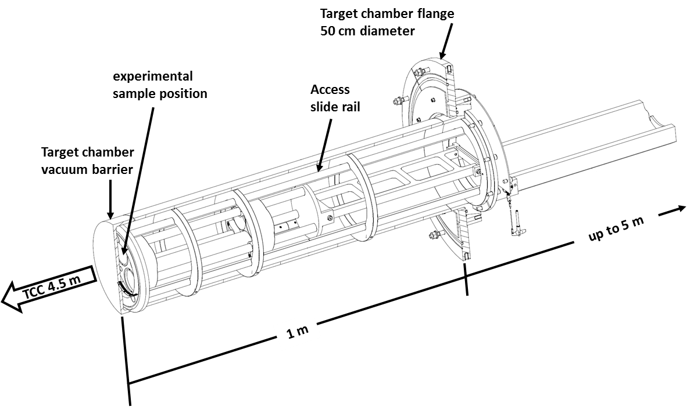
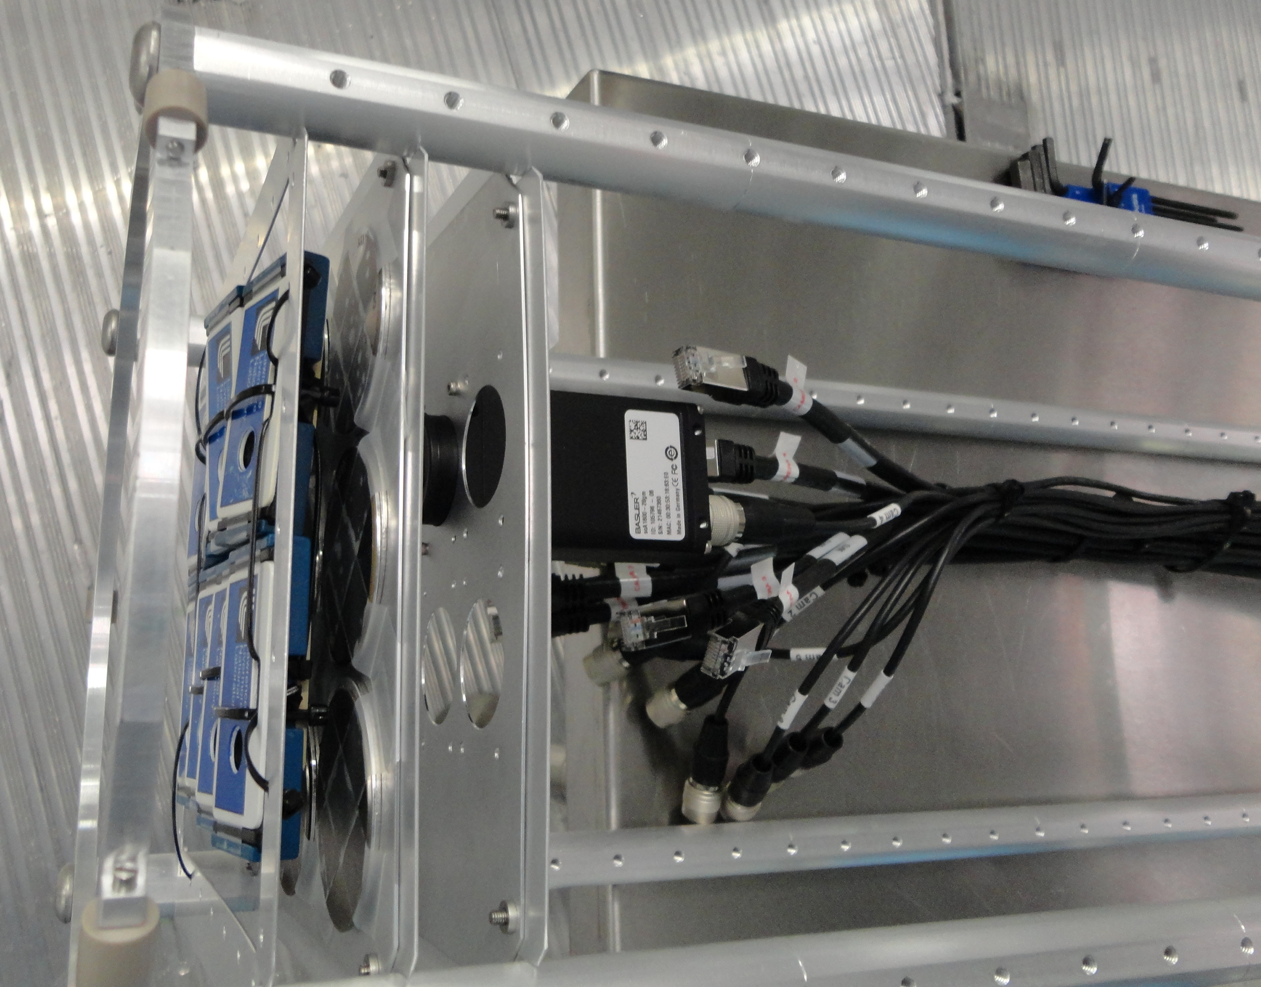
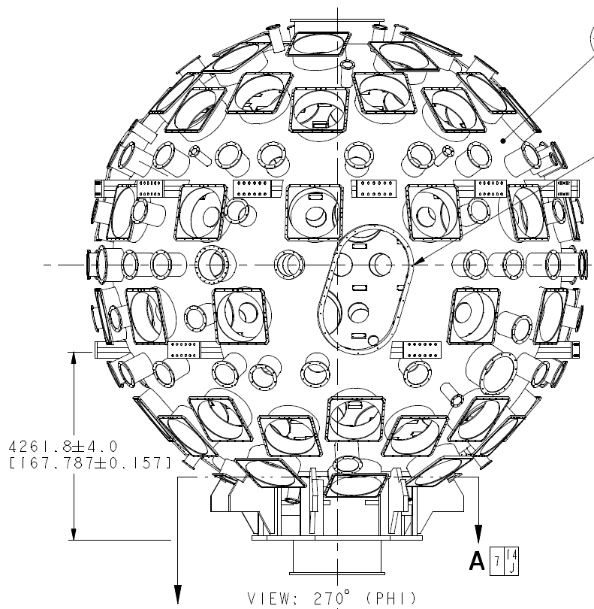
NIF Neutron Experimental Platforms: exterior flange-mounted and reentrant well
A test well may be outfitted with a large-volume neutron experiment seeing up to 10¹⁰ n/cm². Test volume is connected to target bay atmosphere.
Additional experiments may be positioned directly on exterior port flanges. (ex: “nuclear forensic signatures of common cellular telephones”)
 | test well sample | reentrant well | port flange
distance from TCC (cm) | 350 | 375 | 550
sample area (cm²) | 37 | 1250 | 1250
sample depth | 1 | 1000 | 20
solid angle (msr) | 0.3 | 8.9 | 4.1
volume | 37 | 1.25 x 10⁶ | 25,000
max DT neutron yield | 1.7 x 10¹⁶ | 1.7 x 10¹⁶ | 1.7 x 10¹⁶
max fluence (n/cm²) | 1.1 x 10¹⁰ | 1.1 x 10¹⁰ | 4.5 x 10⁹
Test well configuration for camera tests, with spatially-resolved neutron dosimetry.

Slide 21
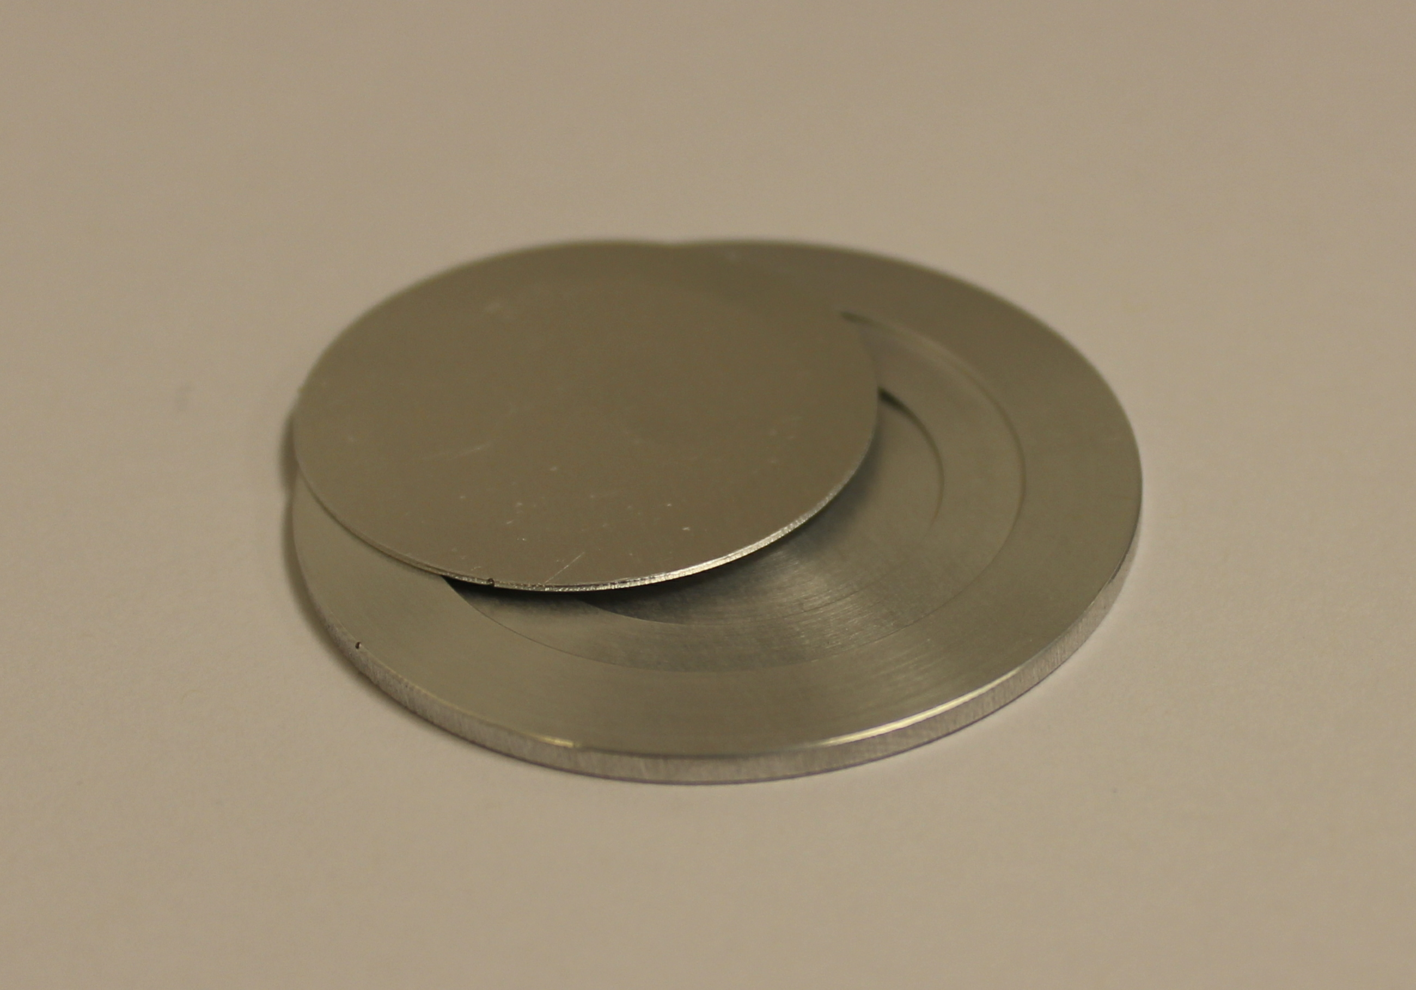
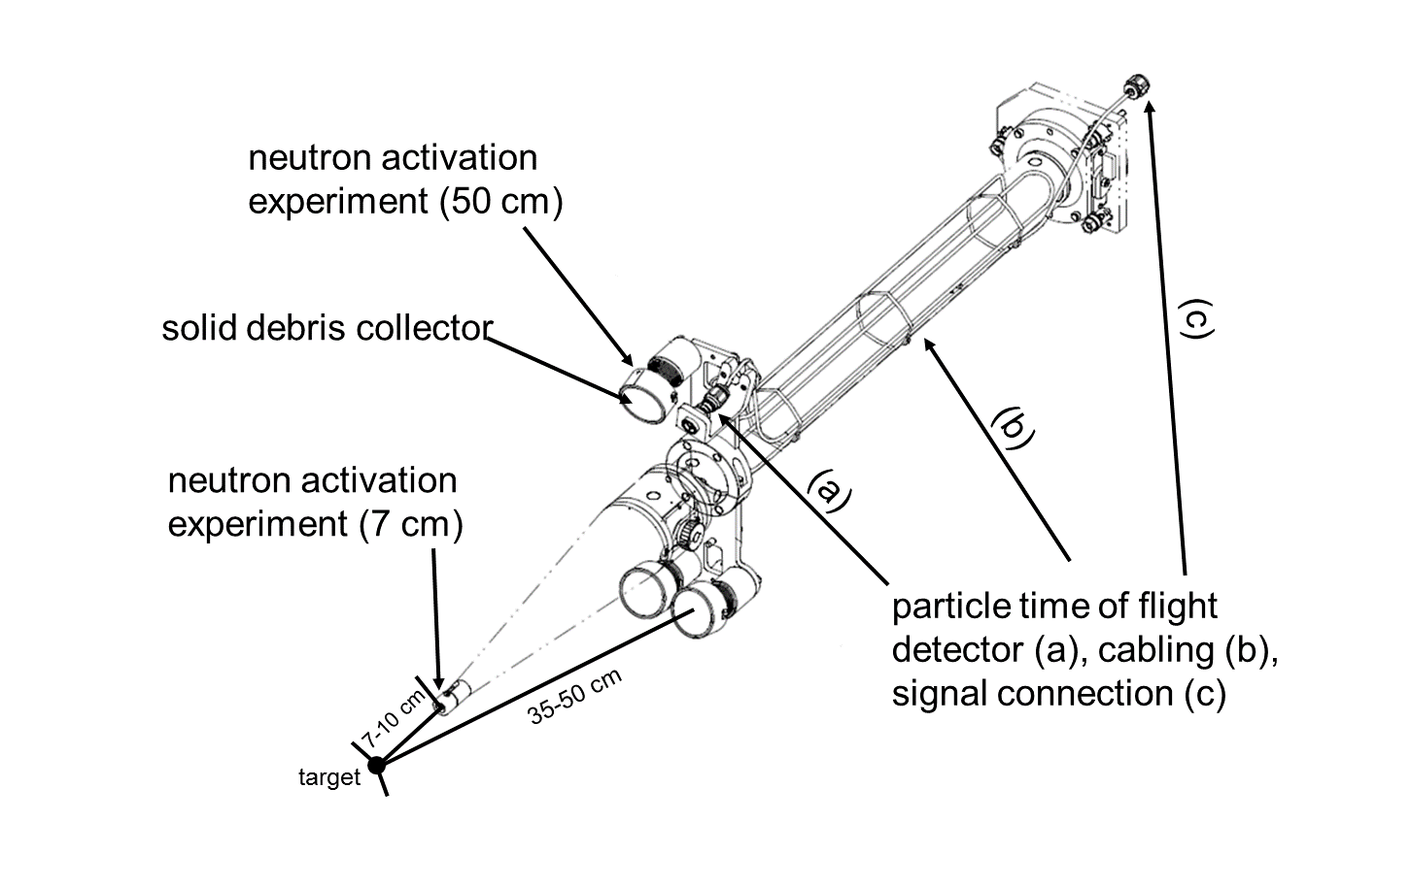
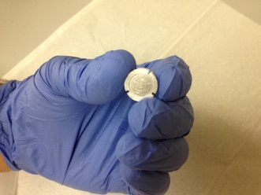
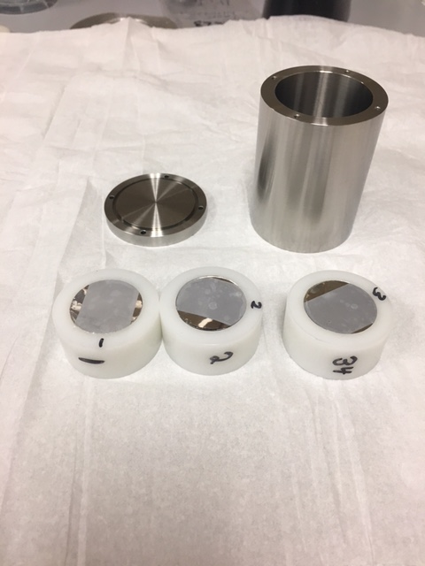
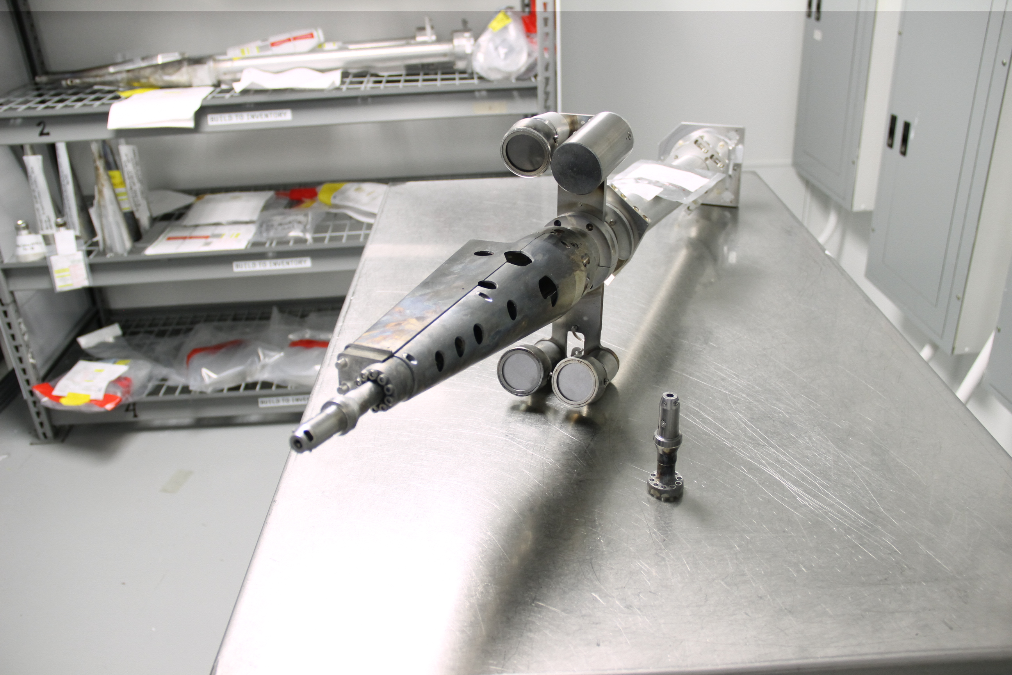
NIF Neutron Experimental Platforms: Snout-mounted auxiliary experiments (passive)
Target Option Activation Device (TOAD)
1-2 g of HEU, DU, Th, Tm, Gd, Nd, Ir, Au, Fe
 | Treefrog | HTOAD | SRC Toad | Snout-NAD
distance from TCC (cm) | 7 | 45 | 50 | 50
sample area (cm²) | 0.5 | 20 | 4.9 | 20
sample depth | 0.14 | 8 | 0.1 | 1
solid angle (msr) | 10 | 10 | 2.0 | 8.0
volume | 0.07 | 160 | 0.5 | 20
max DT neutron yield | 3.7 x 10¹⁵ | 1.7 x 10¹⁶ | 1.7 x 10¹⁶ | 1.7 x 10¹⁶
max fluence (n/cm²) | 6.0 x 10¹² | 6.7 x 10¹¹ | 5.4 x 10¹¹ | 5.4 x 10¹¹
Neutron spectrum tailoring HTOAD
Treefrog
8 cm depth
5 cm diameter
1000 torr
Pressurized gas cell
NIF diagnostic manipulators are used to carry ride-along experiments on neutron-yielding shots. This capability is readily accessible to collaborating groups.
Collaboration with U.C. Berkeley Department of Nuclear Engineering
This is the experimental compliment to a MCNP design study in spectrum tailoring.

Slide 22
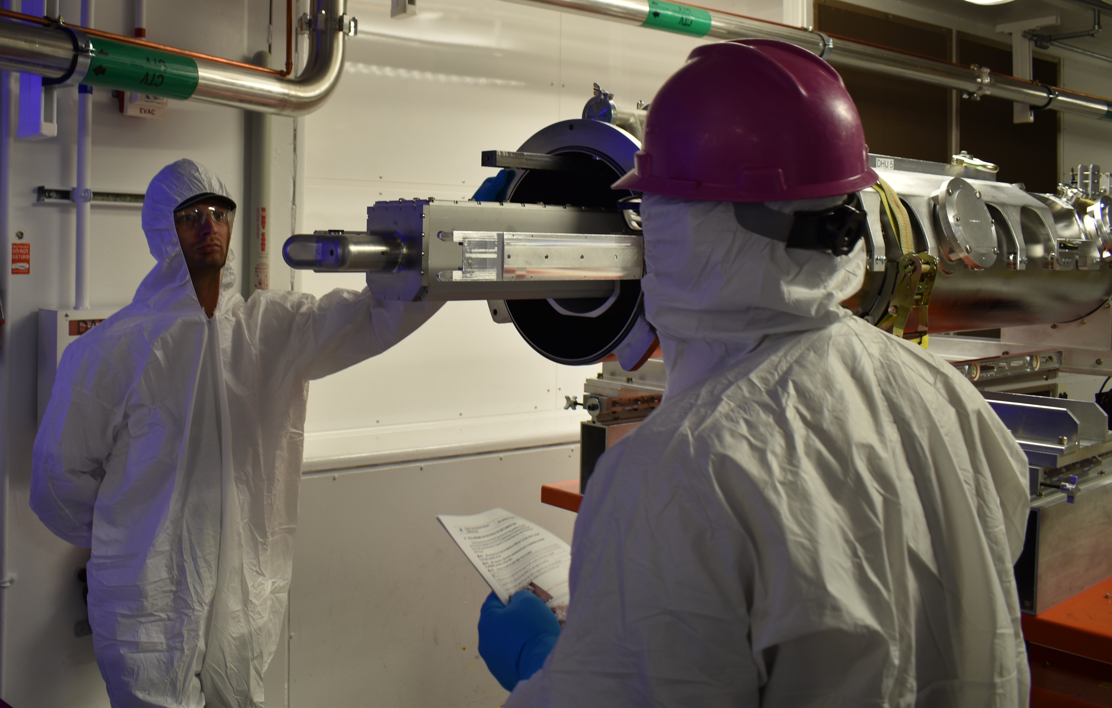
NIF Neutron Experimental Platforms: User-designed dynamic load packages
 | DLP
distance from TCC (cm) | 5
sample area (cm²) | 90
sample depth | 20
solid angle (msr) | 3600
volume | 1800
max DT neutron yield | 3.7 x 10¹⁵
max fluence (n/cm²) | 1.2 x 10¹³
The experimenter designs to fit within the available TANDM space.
Energetic Neutron Platform (ENP)
SNL PI: William J. Martin
2.6 m
* Example based on Sandia TANDM ENP
5.7 cm
17 cm
Energy Tuning Assembly (ETA)
AFIT: Capt. James Bevins
UCB: Racheal Slaybaugh, Lee Bernstein, Bethany Goldblum
LLNL: William Dunlop, Dawn Shaughnessy, Charles Yeamans, Eugene Henry
Technicians install a National Security Applications ENP (Energetic Neutron Platform, Sandia Natl. Lab) in DIM 90-78 for a data collection shot awarded to the Sandia PI
(W. J. Martin) through the NIF User Office.
The UCB/AFIT ETA is designed to transform a NIF neutron source into the objective TN+PFNS neutron spectrum.

Slide 23
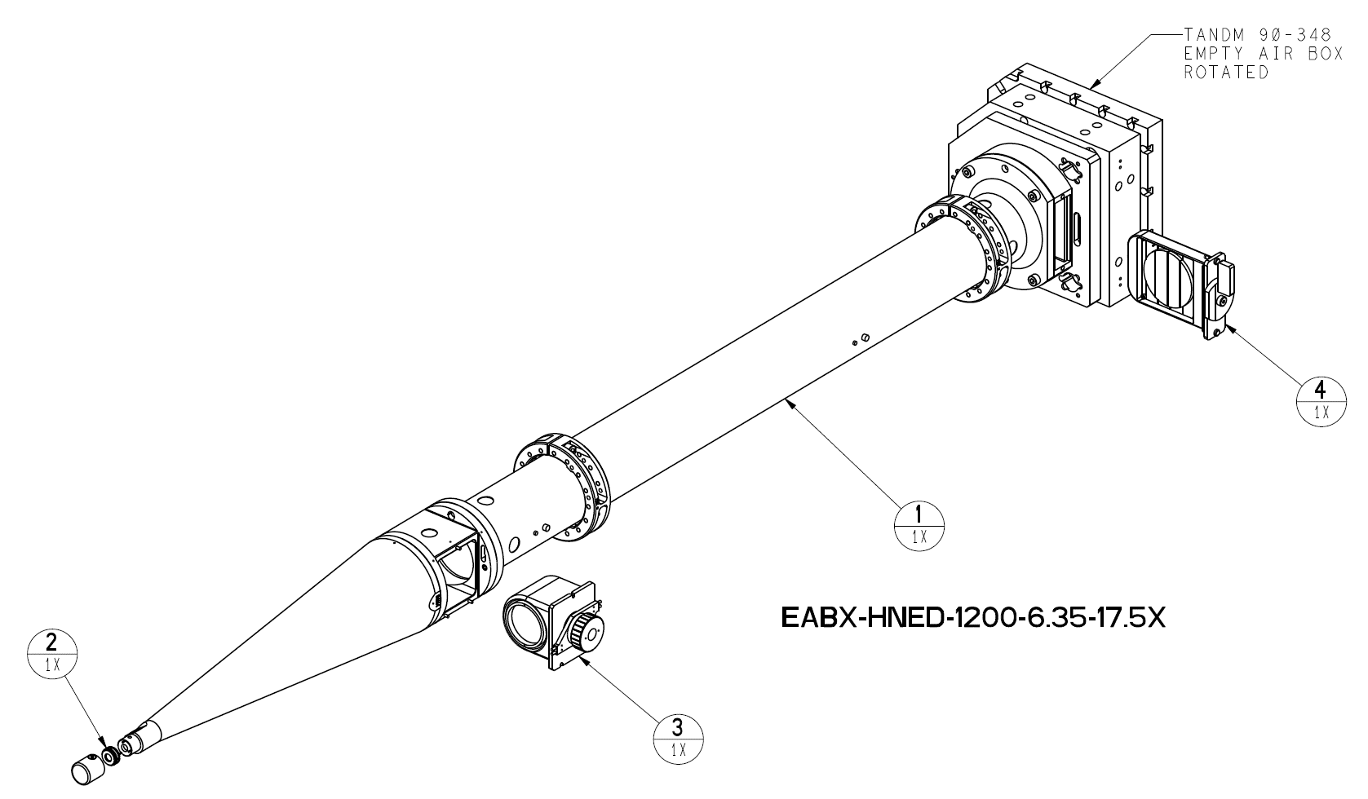
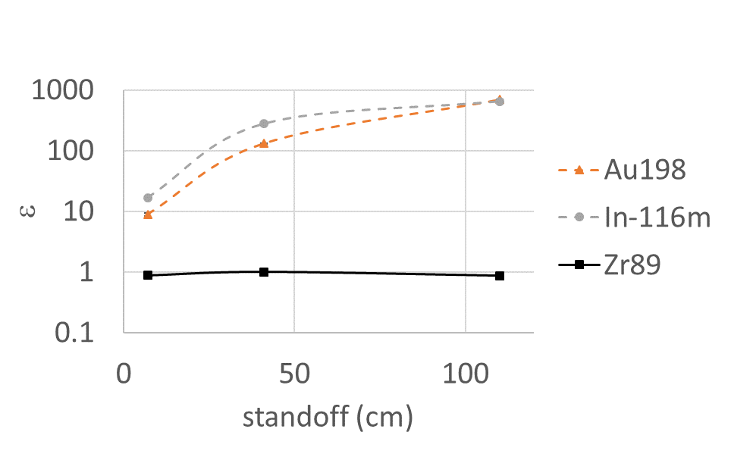
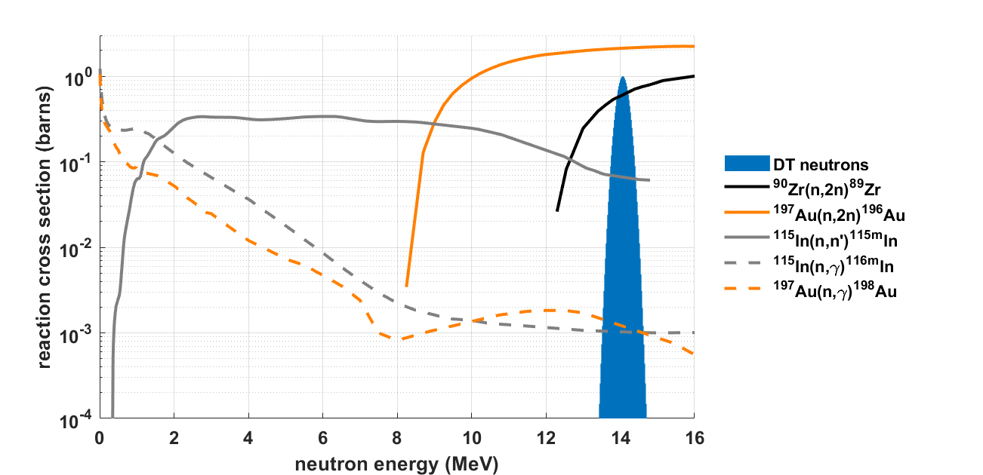
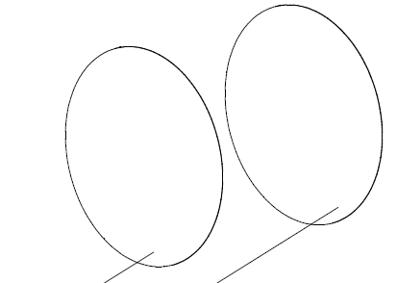
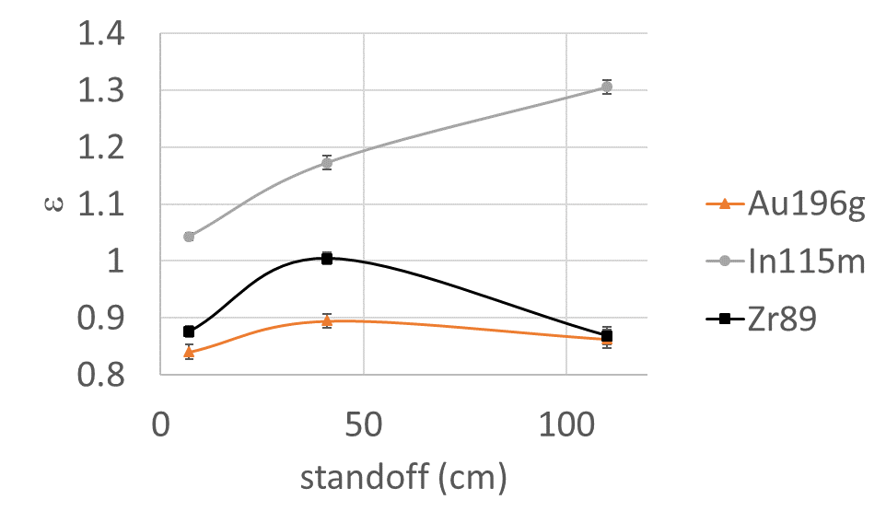
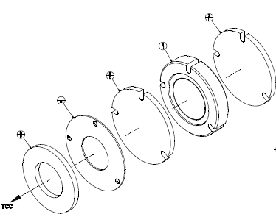
NIF Neutron Experimental Platforms: Passive snout neutron spectrum tuning
Al
Zr
Au
In
ε_{i} wrt vacuum ideal transport
A
110 cm
A
2.1 x 10¹⁰ n/cm²
1.6 x 10¹¹ n/cm²
Al
Zr
Al
Zr
Au
In
Au
location | Standoff (cm) | isotope | N0/n/g measured | N0/n/g MCNP no density | N0/n/g MCNP sample only density | N0/n/g MCNP full density | design N0/n/g
kinematic base | 110 | Au196g | 3.20E-08 |  |  |  | 3.71E-08
kinematic base | 110 | Au198 | 1.61E-08 |  |  |  | 2.33E-11
kinematic base | 110 | In115m | 2.44E-09 |  |  |  | 1.87E-09
kinematic base | 110 | In116m | 1.88E-08 |  |  |  | 2.90E-11
kinematic base | 110 | Zr89 | 9.92E-09 |  |  |  | 1.14E-08
basket | 41 | Au196g | 2.10E-07 |  |  |  | 2.34E-07
basket | 41 | Au198 | 1.93E-08 |  |  |  | 1.47E-10
basket | 41 | In115m | 1.40E-08 |  |  |  | 1.19E-08
basket | 41 | In116m | 5.11E-08 |  |  |  | 1.85E-10
basket | 41 | Zr89 | 7.36E-08 |  |  |  | 7.33E-08
pinhole | 7 | Au196g | 9.81E-06 |  |  |  | 1.17E-05
pinhole | 7 | Au198 | 6.54E-08 |  |  |  | 7.34E-09
pinhole | 7 | In115m | 6.57E-07 |  |  |  | 6.30E-07
pinhole | 7 | In116m | 1.64E-07 |  |  |  | 9.77E-09
pinhole | 7 | Zr89 | 3.03E-06 |  |  |  | 3.45E-06
In
41 cm
7 cm
7.8 x 10¹² n/cm²
1 MeV Si equiv.

Slide 24
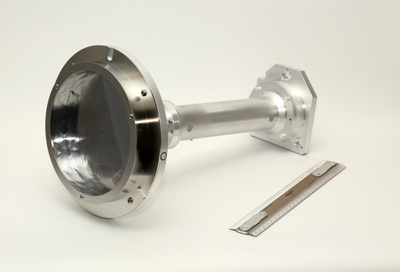
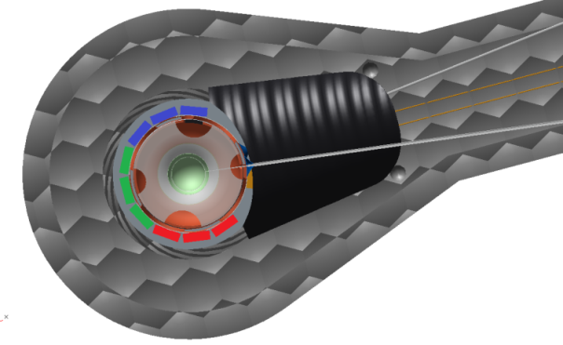
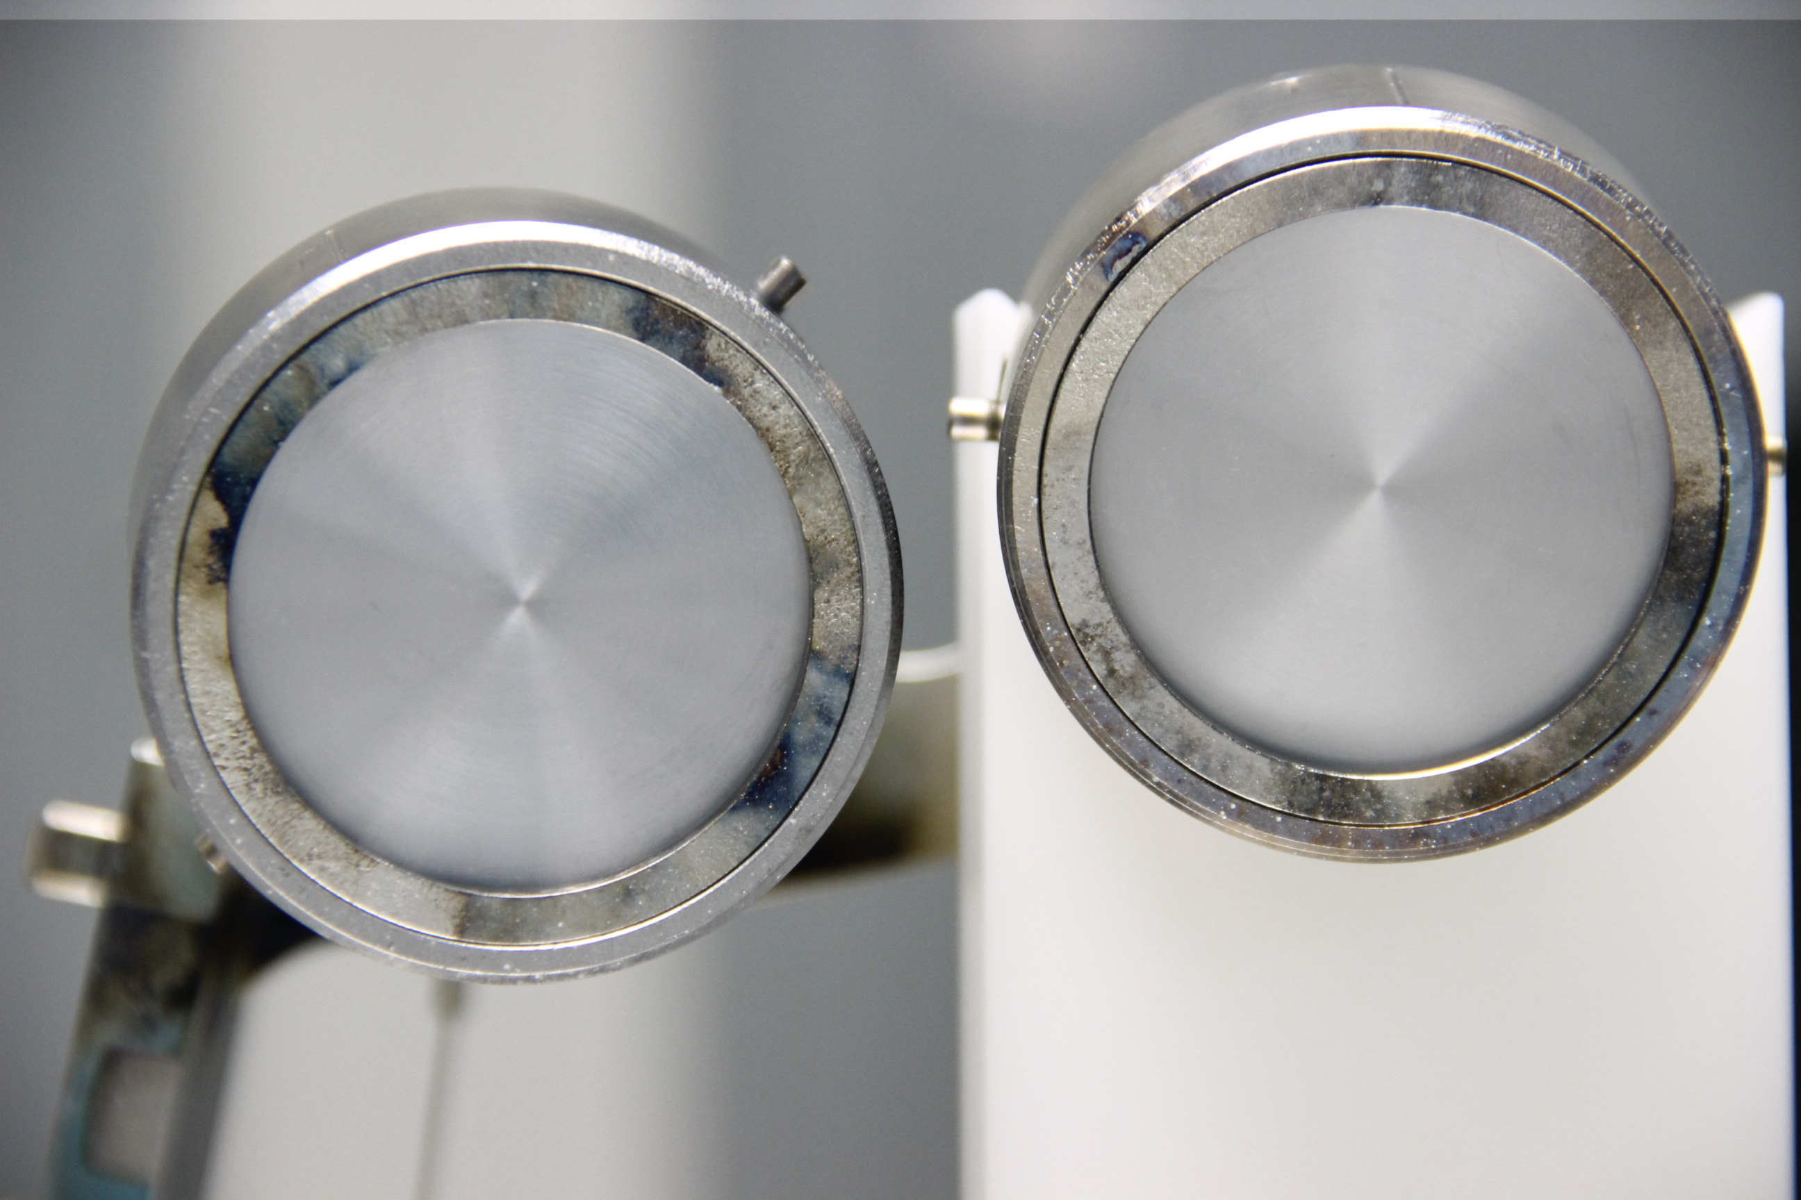
NIF Neutron Experimental Platforms: hohlraum-mounted materials experiments
NIF Nuclear cross sections: PI – Dawn Shaughnessy
Experimental group: Narek Gharibyan, Sherry Faye, John Despotopulos, Pat Grant, Ken Moody, Charles Yeamans
Primary objective: measuring 14 MeV neutron reaction cross sections relevant to post-detonation nuclear forensics
Results:
Debris emission from the target assembly is mostly outwardly radial as expected.
The added foil mass substantially changes the target disassembly dynamics.
Large Area Solid Radiochemistry collector (LASR)
gadolinium
thulium
neodymium
Solid Radiochemistry Collector (SRC)
NIF target fabrication: Brian Yoxall
Solid collection efficiency is 8% of the total target mass in the line of sight to collector.

Slide 25
NIF Neutron Experimental Platforms: high-Z dopant layer in the ablator
NIF Nuclear Forensics: PI – Dawn Shaughnessy
Experimental group: Narek Gharibyan, John Despotopulos, Ken Moody, Pat Grant, Carol Velsko, Bill Cassata, Sherry Faye, Charles Yeamans, Ellen Edwards
Results:
Successful capsule debris collection. Completed experimental series using depleted uranium and conventional capsule fabrication. Development of experimental platform to study fission yield and neutron reaction cross sections under conditions relevant to the nuclear forensic program
Development of advanced doping techniques using micro/nanogram quantities of material.
Uranium-doped CH capsule
Mass-tamped hohlraum
capsule outer surface
175 micron GDP
20 nm DU layer
capsule inner surface
Photo: General Atomics
Photo: Sean Felker
NIF target fabrication
CH plastic capsule, 175 micron thickness with 10¹⁶ atoms of depleted uranium.
SymCDT target with mass-tamped hohlraum
 | capsule | hohlraum
distance from TCC (cm) | 0.1 | 0.5
sample area (cm²) |  | 0.05
sample depth |  | 0.05
solid angle (msr) |  | 200
volume |  | 0.0025
max DT neutron yield | 4.0 x 10¹⁴ | 1.7 x 10¹⁶
max fluence (n/cm²) | 3.2 x 10¹⁵ | 5.4 x 10¹⁵
 | Laser energy | DU recess | Fission yield¹ | Collection efficiency²
N170130-003 | 0.9 MJ | 10 um | 6.56 | 1.53
N160210-001 | 0.9 MJ | 21 um | 4.54 | 0.07
N150907-003 | 1.3 MJ | 10 um | 8.70 | 0.12
DU hohlraum | 1.5 MJ | n/a | 1.00 | 1.00
Normalized ^{137,138,139}Xe and ^{87,88}Kr per 10¹⁵ neutrons
Normalized ⁹⁷Zr (90-315) atoms/cm² per 10¹⁵ neutrons
Capsule and hohlraum debris has been collected successfully on many shots.

Slide 26
National Ignition Facility Neutron Sources outline
Abstract
NIF overview
Using the NIF as a neutron source
Practical consideration for the user
Fusion spectra available
NIF neutron sources
Polar direct drive
CH PDXP
SiO₂ DDEP
Indirect drive
ICF cryogenic layered
DT gas Symcaps
IDEP
Summary table
Experimental Platforms
Exterior flange mounted and reentrant well
Snout-mounted auxiliary positions
Dynamic load packages
Hohlraum
Capsule
Neutron Source and Experimental Platform Development
Capsule microinjection doping
Neutron source development: yield enhancements
Experimental support ring and reduced source standoff
Reference table

Slide 27
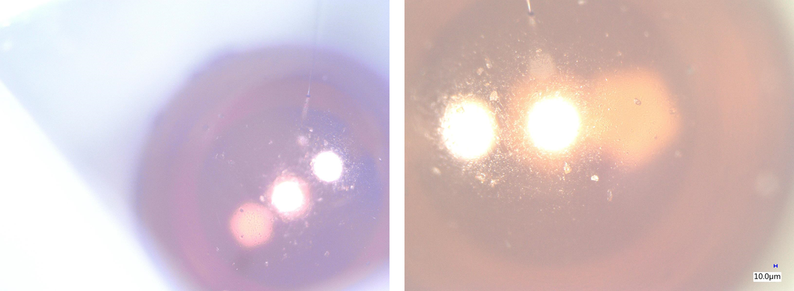
Developmental Platforms: Capsule Microinjection Doping
Goal: Add 10¹⁶ radioactive atoms to the inner surface of a capsule
More efficient and faster than sputtering or ion implantation; allows the use of radionuclides as dopant atoms
Prevents issues related to outer surface roughness
Investigating direct surface coating with metal oxide aerogels (analogous to established foam doping methods)
Micro injector adding material through fill tube hole
Aerogel layer inside capsule (before drying)
John Despotopulos

Slide 28
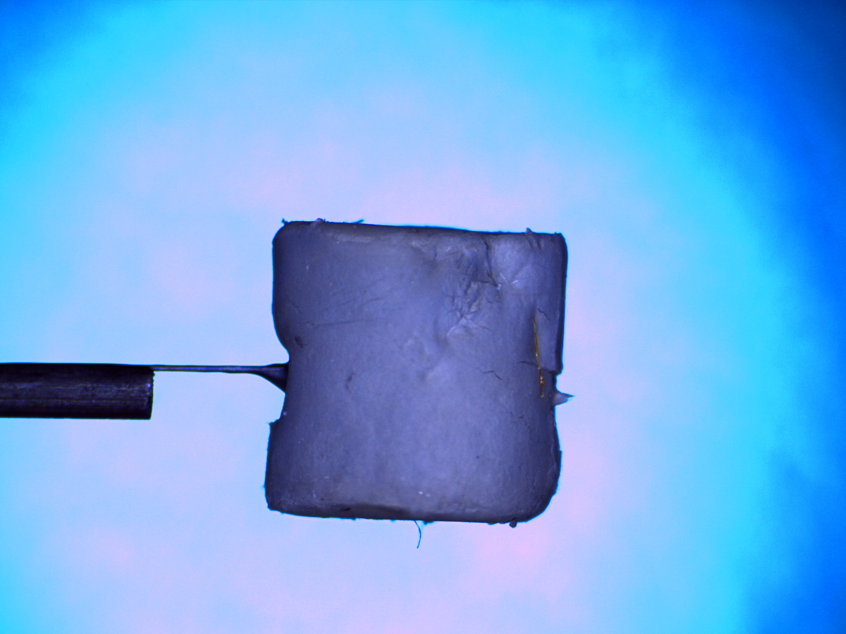
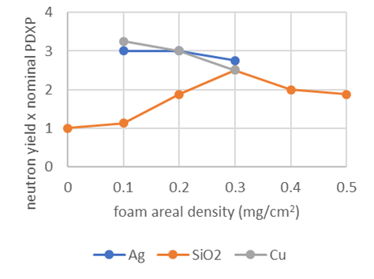
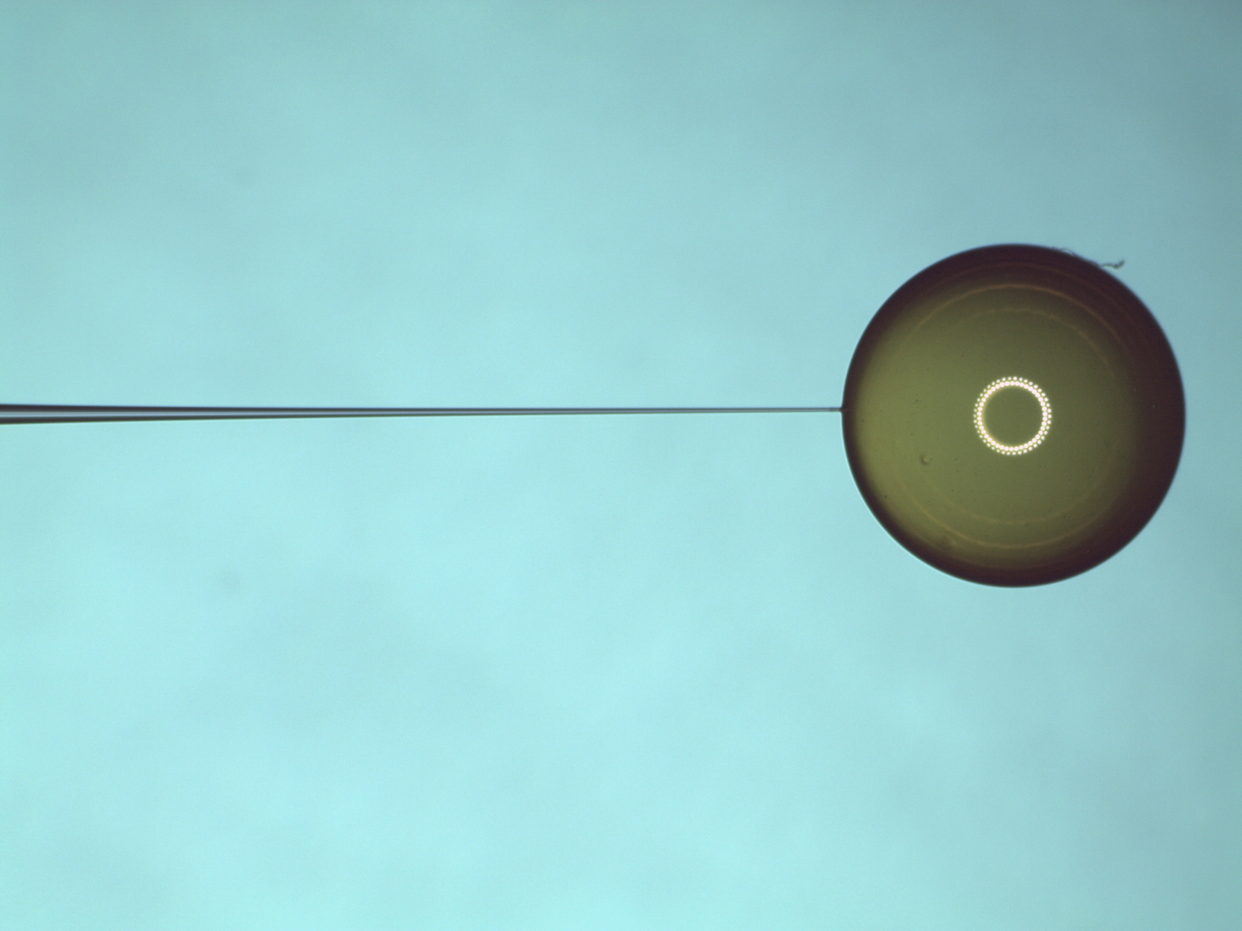
Neutron Source development: HYDRA calculates the combined environment target is a better source of both neutrons and x-rays than a bare capsule.
+
2.9 mm GDP (Kelly Youngblood)
~12 mg/cc silver foam
(Sergei Kucheyev)
As a neutron source, a spherical metal foam shell on a capsule driven by a 2 ns square pulse is calculated to better than a bare capsule.
This combines two well-established target fabrication techniques.
Addition of a metal foam layer, as is currently fabricated for x-ray source targets, is predicted to increase neutron yield 2-3x.
Energy range (keV) | XRCE (%) |  | Foam/bare XRCE
 | with foam | bare capsule
0-1.5 | 9.5 | 7.5 | 1.3
1.5-3 | 3.9 | 2.7 | 1.4
3-7 | 9.2 | 0.95 | 9.7
7-10 | 0.27 | 0.09 | 3.0
10-250 | 0.93 | 0.05 | 18.6
0-250 | 24.4 | 11.6 | 2.1

Slide 29
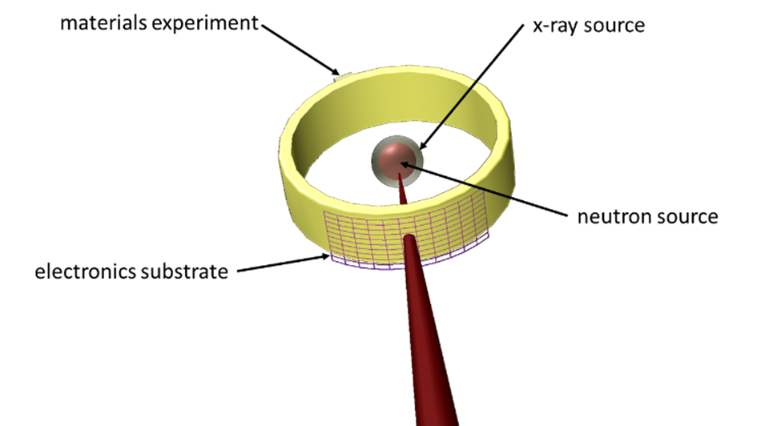
Advanced Experimental Capability: Get the user experiments closer to the neutron source.
A support ring added to the target assembly decreases standoff substantially.
Experiments positioned on the ring see 14 MeV neutron fluences 100x greater than can be achieved at any other facility.
An articulated sample positioner would bring the nondestructive testing capability within the cryogenic shroud clearance to within 2 cm of a layered cryogenic neutron source.
 | support ring | support ring with improved source | articulated positioner
distance from TCC (cm) | 1 | 1 | 2
sample area (cm²) | 3 | 3 | 0.5
sample depth | 0.5 | 0.5 | 3
solid angle (msr) | 3000 | 3000 | 125
volume | 1.5 | 1.5 | 1.5
max DT neutron yield | 3.7 x 10¹⁵ | 1.3 x 10¹⁶ | 1.8 x 10¹⁶
max fluence (n/cm²) | 2.9 x 10¹⁵ | 1.0 x 10¹⁶ | 3.6 x 10¹⁴

Slide 30
National Ignition Facility Neutron Sources outline
Abstract
NIF overview
Using the NIF as a neutron source
Practical consideration for the user
Fusion spectra available
NIF neutron sources
Polar direct drive
CH PDXP
SiO₂ DDEP
Indirect drive
ICF cryogenic layered
DT gas Symcaps
IDEP
Summary table
Experimental Platforms
Exterior flange mounted and reentrant well
Snout-mounted auxiliary positions
Dynamic load packages
Hohlraum
Capsule
Neutron Source and Experimental Platform Development
Capsule microinjection doping
Neutron source development: yield enhancements
Experimental support ring and reduced source standoff
Reference table

Slide 31
NIF Neutron Sources: Reference Table
topic | reference
NIF facility | B M Van Wonterghem et al 2016 Fusion Sci. Technol. 69 452-469
NIF optics loop | K R Manes et al 2016 Fusion Sci. Technol. 69 146-249
NIF laser performance optimization module (optics use calculation) | M Shaw and R House, Proc SPIE, High Power Lasers for Fusion Research III; 93450E (2015)
NIF debris and shrapnel | N D Masters et al 2016 J. Phys.: Conf. Ser. 717 012108
NIF diagnostic instrument manipulators | R Plummer 2013 Proc. SPIE 8850 885005
NIF neutron spectra (DT) | B Appelbe and J Chittenden, High Energy Density Physics 11 (2014) 30-35
NIF neutron spectra (DT downscatter) | D C Wilson et al 2002 Nucl. Instrum. Meth. A 488 400–409
NIF neutron spectra (TT) | D T Sayre et al 2013 Phys. Rev. Lett. 111 052501
NIF neutron spectra (DD) | H Brysk 1973 Plasma Phys. 15 611
polar direct drive | N S Krasheninnikova, S M Finnegan, and M J Schmitt, Phys. Plasmas 19, 012702 (2012)
polar direct drive | R S Craxton et al., Physics of Plasmas 22, 110501 (2015)
Indirect drive Symcaps (experiment) | G A Kyrala et al., Physics of Plasmas 18, 056307 (2011)
Indirect drive Symcaps (simulation) | S V Weber et al., Physics of Plasmas 21, 112706 (2014)
indirect drive layered sources | N B Meezan et al 2017 Plasma Phys. Control. Fusion 59 014021
indirect drive layered sources, HDC | S Le Pape et al “Energy gain from an imploding shell at the National Ignition Facility,” submitted to Physical Review Letters
indirect drive target engineering | A V Hamza et al. 2016 Fusion Sci. Technol. 69 395-406
indirect drive target engineering | T Parham et al 2016 Fusion Sci. Technol. 69 407-419
indirect drive exploding pushers | S Le Pape et al. Phys. Rev. Lett. 112 225002 (2014)
IDEPs for nuclear forensics | D A Shaughnessy et al 2016 J. Phys.: Conf. Ser. 717 012080
NIF solid debris collection capability | D A Shaughnessy et al 2012 Rev. Sci. Instrum. 83 10D917
enhanced NIF solid debris collection capability | C Waltz et al 2017 Proc. SPIE 10390 103900H
NIF HEU fission yield measurements | N Gharibyan et al. 2015 J. Radioanal. Nucl. Chem. 303 1335
NIF passive neutron experiments | C B Yeamans and N Gharibyan 2016 Rev. Sci. Instrum. 87 11D702
gas cell capability at NIF | A Ratkiewicz et al 2016 Rev. Sci. Instrum. 87 11D825
neutron effects measurements at NIF | W J Martin et al 2017 Journal of Radiation Effects, Research and Engineering 35
neutron effects measurements at NIF | W J Martin, submitted to Journal of Radiation Effects, Research and Engineering

